Slide 1
English Premier Football Prediction
CS677 – Term Project
Wasupol Tungsakultong

Slide 2
Objectives
As one of the most popular sports on the planet.
There are many challenges in terms of data such as shot-per-game.
These data always rapidly changed play-by-play collection.
Data Science in football is the ability to evaluated team’s performance
Notes:
football has always been followed very closely by a large number of people
in games and use that information to attempt to predict theresult of future

Slide 3
Prepare Datasets
All the data used from (2014/15 – 2019/20 seasons)
https://www.kaggle.com/saife245/english-premier-league
Data from current season from
https://fixturedownload.com/results/epl-2020
Notes:
Football-Data would like to acknowledge the following sources which have been utilised in the compilation of Football-Data's results and odds files. Historical results: International Soccer Server - http://sunsite.tut.fi/rec/riku/soccer.html European Football - http://www.eurofootball.be/ RSSSF Archive - http://www.rsssf.com/ Current results (full time, half time) TBWSport - http://www.tbwsport.com Livescore- http://www.livescore.com Match statistics Sportinglife, ESPN Soccer, Bundesliga.de, Gazzetta.it and Football.fr Bookmakers betting odds Betbrain - http://www.betbrain.com Betbase - http://www.betbase.info Betting odds for weekend games are collected Friday afternoons, and on Tuesday afternoons for midweek games. Additional match statistics (corners, shots, bookings, referee etc.) for the 2000/01 and 2001/02 seasons for the English, Scottish and German leagues were provided by Sports.com (now under new ownership and no longer available).

Slide 4
Assumptions
All prediction is made by assumed that this season has not yet started.
Used previous 6 seasons as the training set
There are some additional factors that did not bring to consider in this project
Player’s injury
Match Strategy and Tactics
Player’s styles
Many more…

Slide 5
Choice of Models
Logistic Regression
k-Nearest-Neighbors
Gaussian Naive Bayes
Random Forest Classifier
Decision Tree Classifier
SVM Regressor with Linear kernel
LDA
QDA
Notes:
Match strategy, tactics, and analysis•Identifying players’ playing styles•Player acquisition, player valuation, and team spending•Training regimens and focus•Injury prediction and prevention using test results and workloads•Performance management and prediction•Match outcome and league table prediction•Tournament design and scheduling•Betting odds calculation

Slide 6
Results
using the SVM model with a linear kernel function, which we will choose in order to build our match outcome classification models

Slide 7
Results
We obtain the lowest RMSE by using the Random Forest for match score for both Home and Away.
while Away goal score accuracy is higher with SVM.

Slide 8
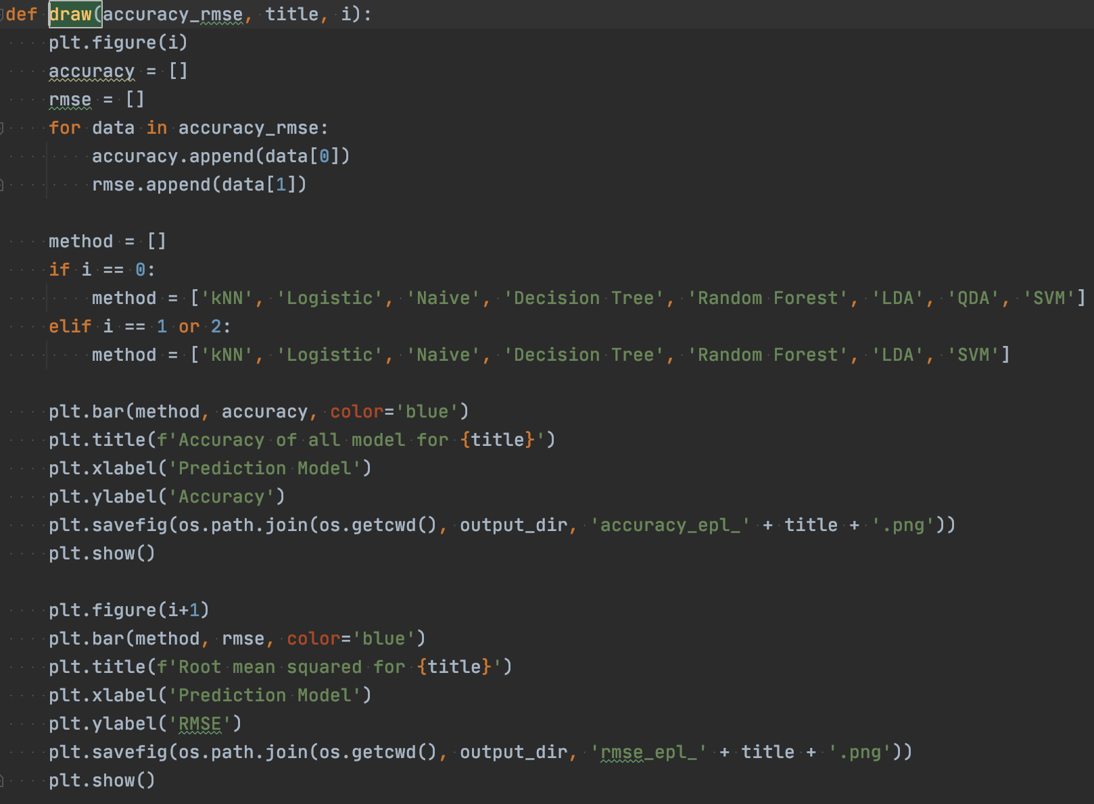
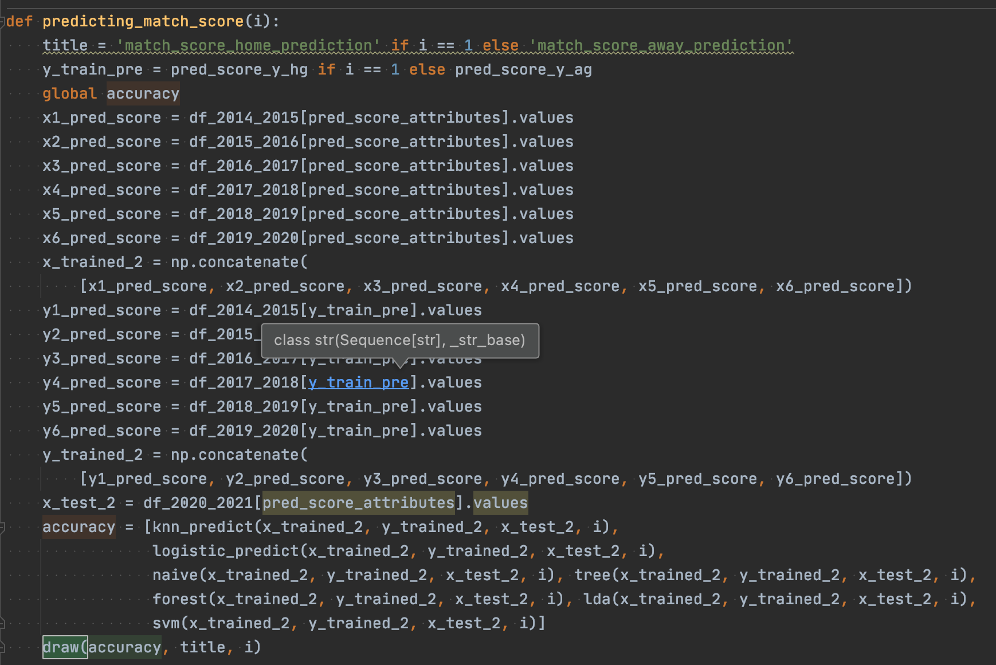
Results (Python)
Here are sample how to use data to create models.

Slide 9
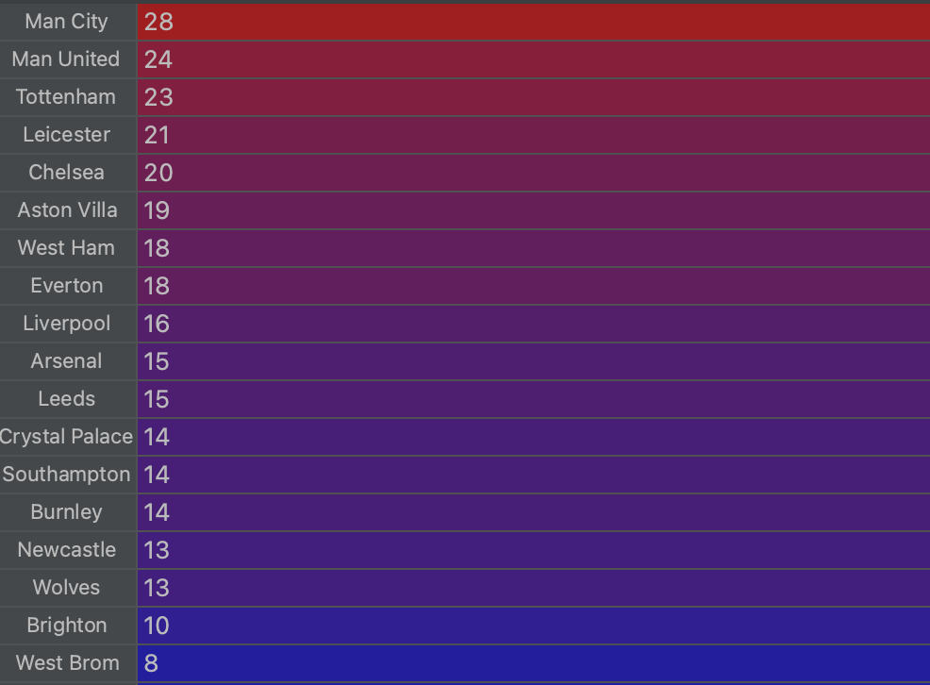
Results
From the best prediction in lowest RMSE and highest accuracy (Random Forest) Man City will be champion for this season with 28 wins

Slide 10
Evaluation
Match outcome classification results
Match Score outcome classification results
RMSE in each models

Slide 11
Conclusion
Finding data is challenges
There still are many factors that need to be consider in real football game
Players centric stats
Games stats, like corners, shots, tackles
And Many more.

